Slide 1


Lucid Transit
Team Members:
2020107 Mr. Daniyal Umer Haral
2020506 Mr. Usman Tahir
2020091 Mr. Asher Khalid
Supervisor
Mr./Dr. Masroor Hussain Co-supervisor
Mr./Dr. Talha Laique
Faculty of Computer Sciences and Engineering Ghulam Ishaq Khan Institute of Engineering Sciences and Technology, Pakistan
Notes:
These slides just offer a template. You may change the color scheme and arrangement of items. However, the information contained on each slide should be what is mentioned.
Once the proposal is accepted/modified, students will be asked to submit a detailed proposal/vision document as per requirements.
1

Slide 2
Recap
The purpose of the project is to revolutionize urban transportation planning and resource allocation. By harnessing the power of advanced AI technologies, Lucid Transit is designed to automate the monitoring of traffic patterns and provide accurate, real-time data on passenger counts and vehicle categorization. Its primary goal is to eliminate the shortcomings of traditional manual methods, which are often time-intensive, error-prone, and reliant on human intervention.

Slide 3
Introduction / Problem Statement
What is the problem you have identified?
Traditional methods of traffic and passenger flow monitoring are labor-intensive and error-prone.
Hinders effective transportation planning and resource allocation.
LT addresses these challenges using advanced analytics and AI technologies.
Provides clear and accurate data.
Facilitates efficient traffic management.
Ensures safety and convenience for urban commuters.
What is the existing/conventional way to solve the problem?
Transportation authorities traditionally use time-consuming traffic surveys.
Personnel are physically stationed at locations for manual counts.
Method is resource-intensive.
Prone to errors due to human factors.

Slide 4
Requirements Gathering Methodology

Slide 5
Requirements Elicitation Technique(s) Followed
Requirements gathered through the proposal given by KP-CTA.

Slide 6
Project - Assumptions & Constraints
Data Accuracy: Constraints related to the accuracy and quality of data from cameras and sensors.
Weather Conditions: Environmental factors, such as extreme weather conditions, may affect the performance and reliability of cameras.
Processing Power: Hardware limitations may affect the system's processing capabilities for real-time data analysis.
Access Control: Constraints on user access permissions and role-based security measures.
Data Encryption: Requirements for data encryption in transit and at rest to ensure security.
Integration with Existing Systems: Constraints regarding the compatibility and integration with existing traffic management systems.

Slide 7
Requirements Specifications

Slide 8
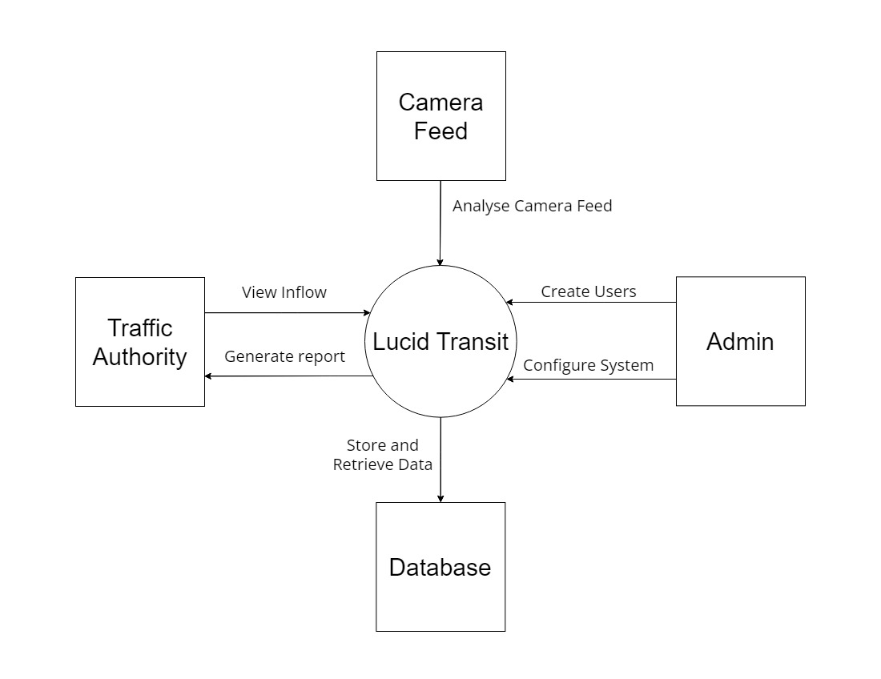
Context Diagram / High Level Block Diagram

Slide 9
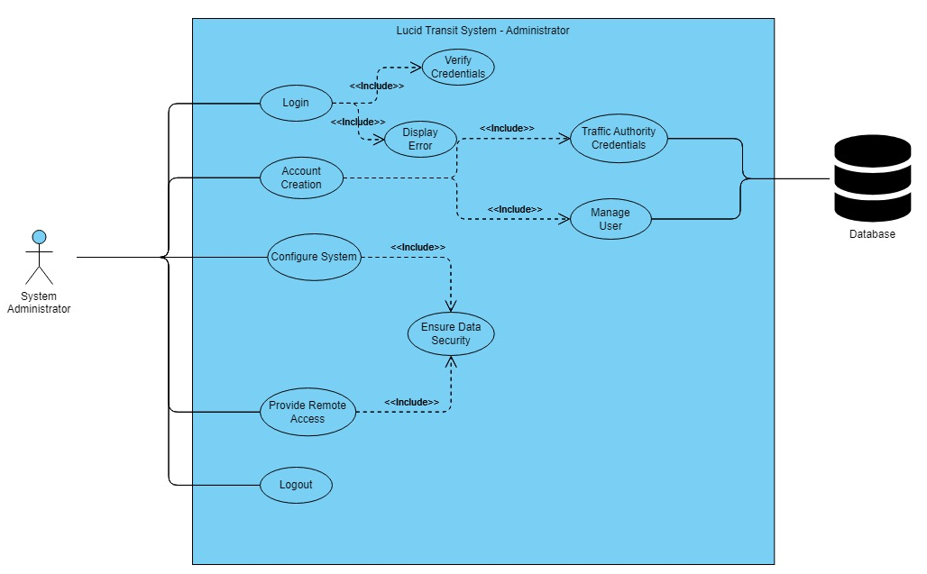
Use Case Diagram (Admin View)

Slide 10
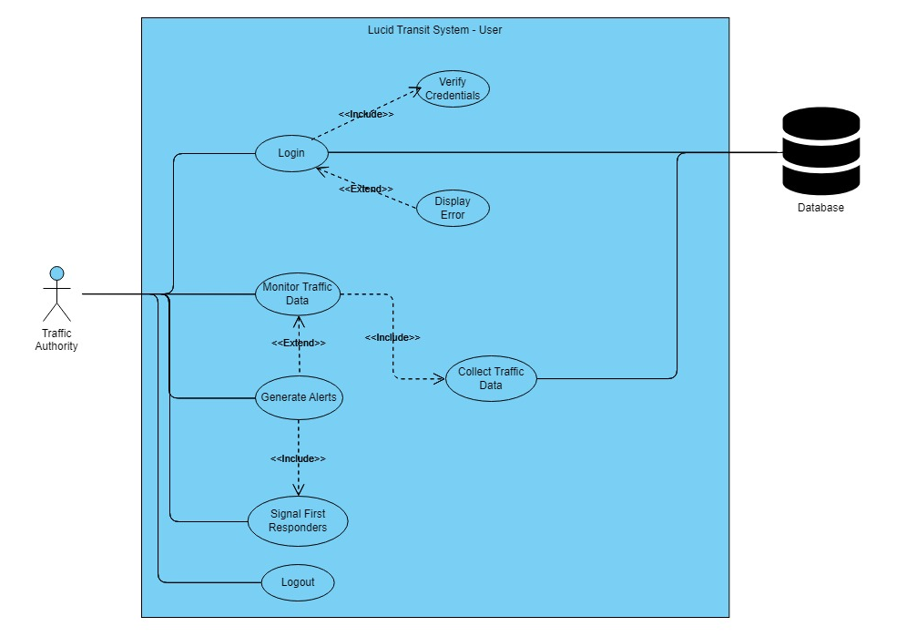
Use Case Diagram (User View)

Slide 11
Distinguishing Functional Requirements
The system will allow Traffic Authority personnel to login into the system
The system will detect vehicles approaching the Toll Plaza.
The system will give an approximate number of passengers inside the vehicle
The system will detect license plate numbers from the image
The system will display collected data

Slide 12
Distinguishing Non-Functional Requirements
Security of data stored on the database and the application should be protected against malware attacks. Unauthorized individuals cannot access the application and database
Scalability and the level of performance the system provides should remain unchanged
Availability of application so that users can interact anytime.
Accurately estimate the vehicle and passengers
The UI of the application will be user-friendly and will have a responsive web design.
Data Integrity by validating before entering the database and it should fulfil all the constraints
Maintenance done when the customer traffic is minimum

Slide 13
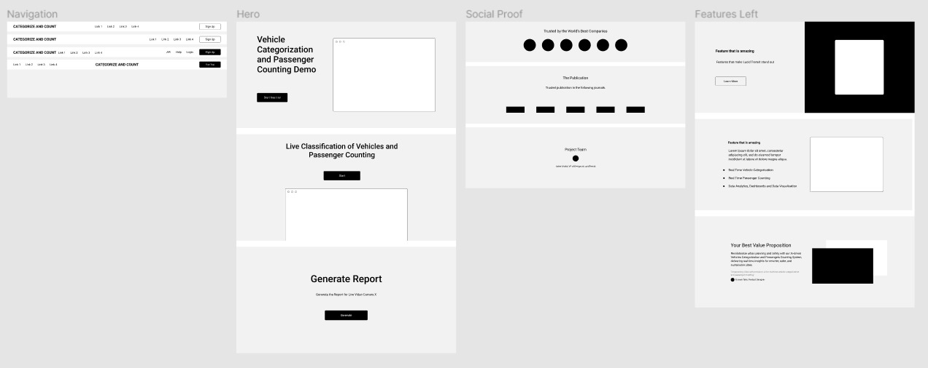
User Interface (Tentative)

Slide 14
Any other external requirements
The LT system's external interface requirements encompass various aspects. It must receive live video feeds and data from traffic cameras and sensors.
Integration with external data sources like traffic databases and weather services. Interaction with third-party services, APIs, and mapping platforms must be detailed.
User interfaces should support multiple browsers, operating systems, and mobile devices.
Encryption for data transfer and integration with performance monitoring tools are also addressed. These requirements ensure seamless integration, data exchange, and compliance with standards and regulations.

Slide 15
Project Design

Slide 16
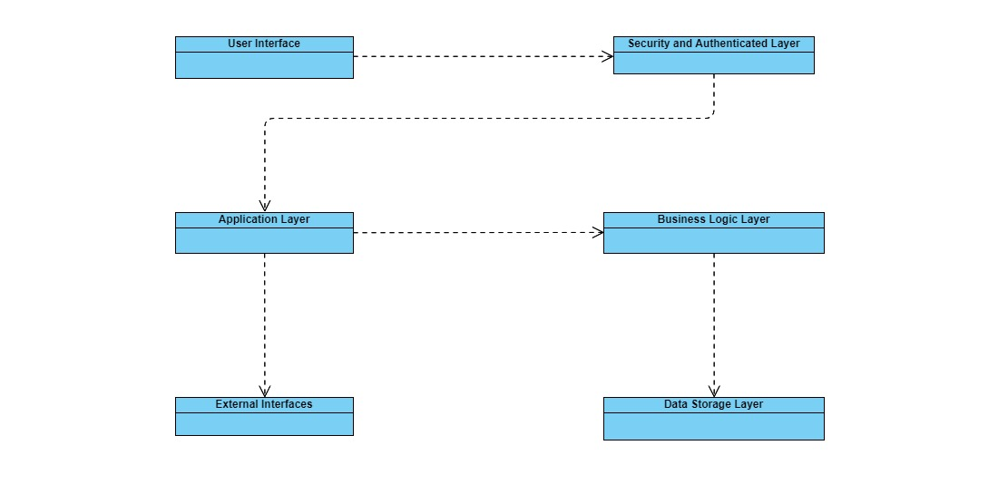
System Architecture

Slide 17
Different UML Diagrams
Logical View Diagram
Activity Diagrams
Physical View Diagrams

Slide 18
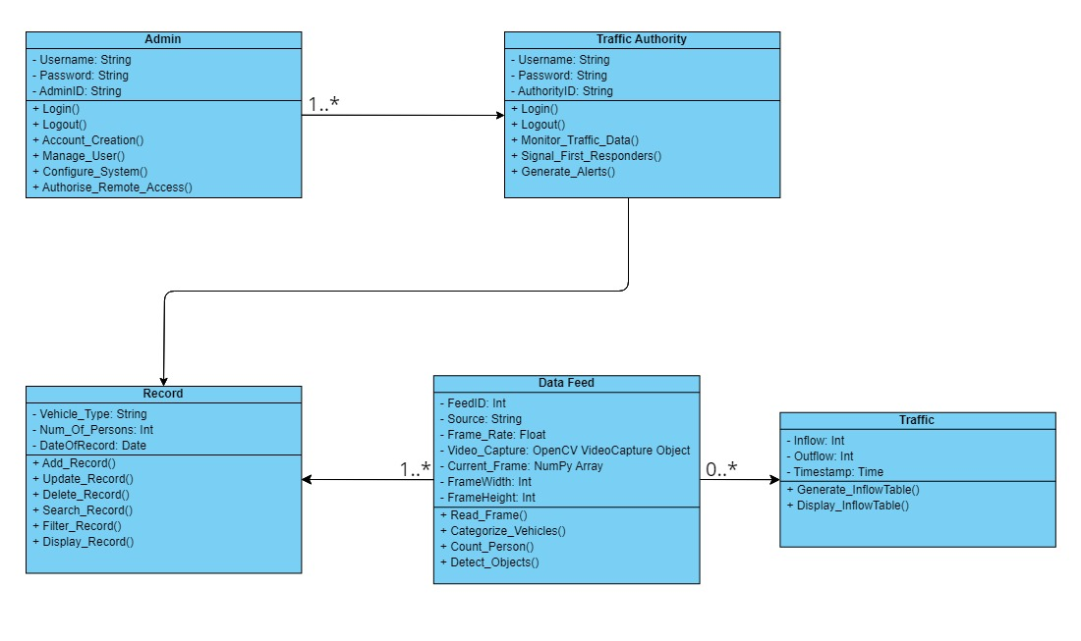
Logical View Diagram

Slide 19
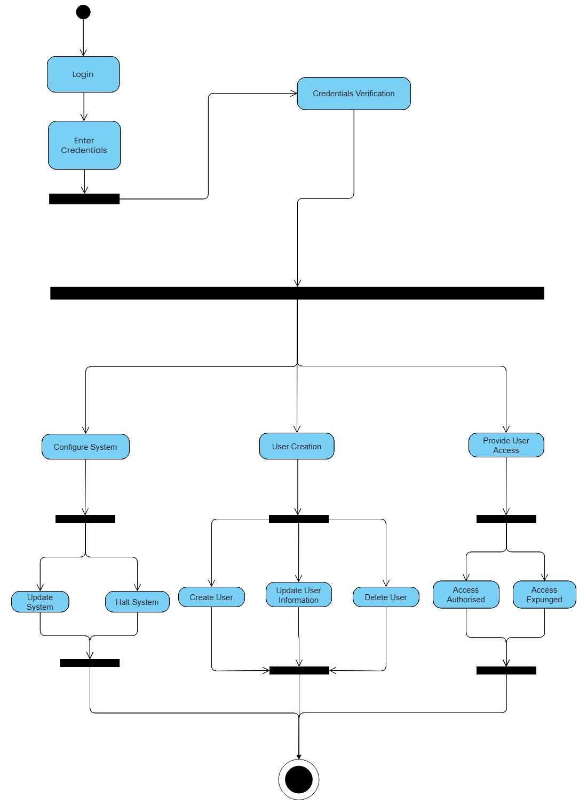
Activity Diagram (Admin)

Slide 20
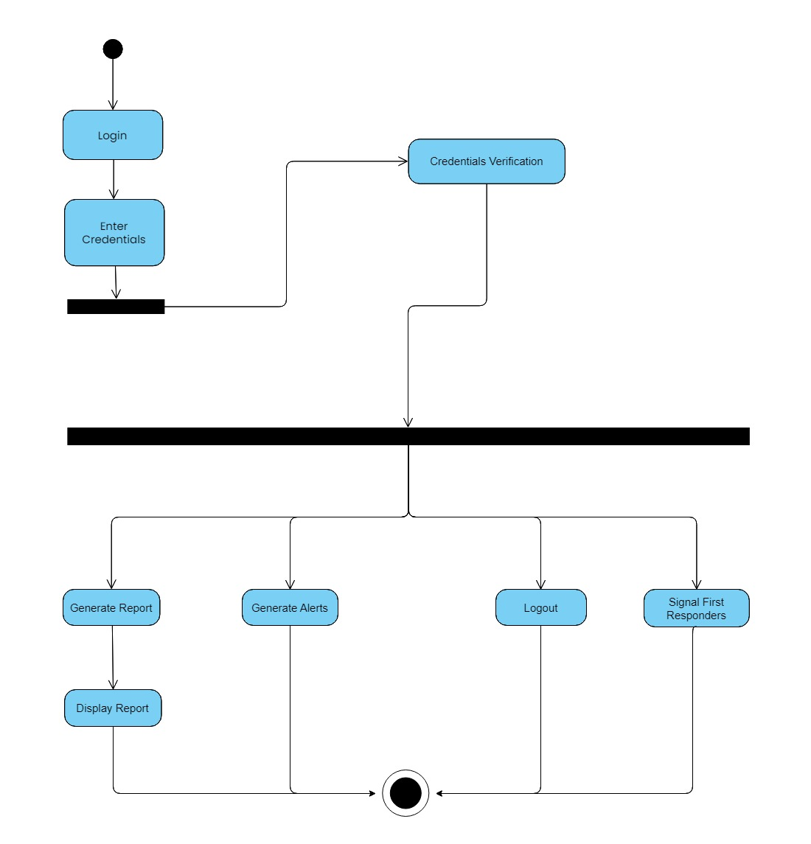
Activity Diagram (User)

Slide 21
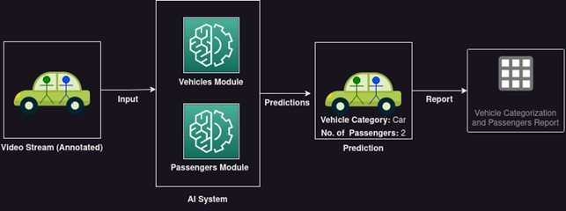
Physical View Diagram

Slide 22
Project Management

Slide 23
Project Management Tool
https://lucidtransit.atlassian.net/jira/software/projects/LUC/boards/1

Slide 24
Project Repository
Git or Bitbucket etc.

Slide 25
Division of Tasks

